Slide 1
Credit Default Analysis
Christian de Chenu

Slide 2
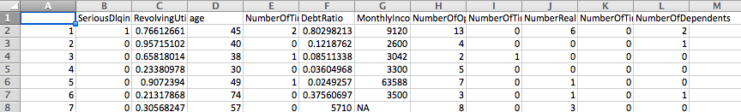
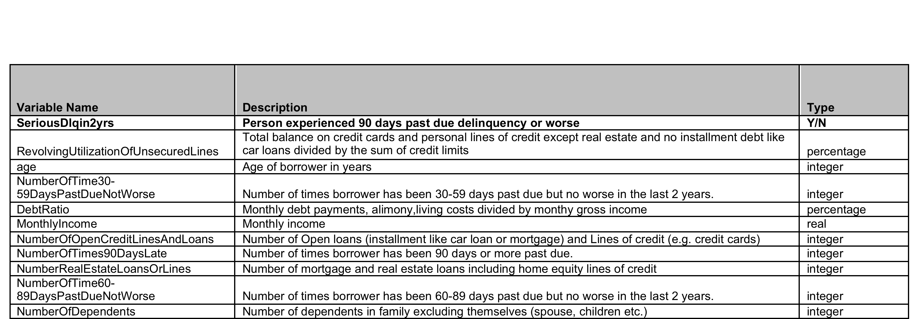
The Data Set
150,000 Borrowers (150,000 Training Set, 100,000 Test Set)
10 Independent Variables, 1 Dependent Variable
Of 150,000 entries in the training set, 10,026 are cases of default (6.68%).

Slide 3
Method 1: Logistic Regression First attempts
Parameters:
:
Penalty = L1 or L2.
Results:
circa 0.93 on training set and then circa 0.68 on test set.
L1 marginally better (0.69 vs 0.68)

Slide 4
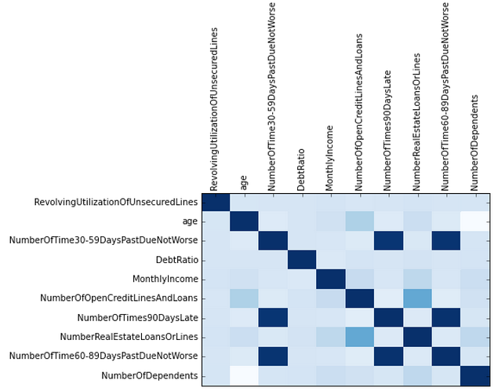
Correlation Matrix

Slide 5

Method 2: Naïve Bayes
Training set Confusion Matrix:
Results:
Similar to logistic regression
0.93 on training and 0.69 on test
A lot of false positives. Model is no better than simply assuming noone defaults! Score will be about 0.93! (circa 7% wrong)

Slide 6

Cleaning the data
Already removed N/A
Age > 0
Removed outliers from other variables
Results:
Fit looks slightly worse on training set, but note there is a big change on number of True Negatives compared to false positives
Much better results on test set
Logistic regression
0.68 -> 0.85
Naïve Bayes
0.69 -> 0.83
Winning entry on competition was 0.869558. Getting close!
Next steps? Further consideration of meaning of variables and further cleaning needed.

Slide 7
How to deal with data codes?
Variable: NumberOfTimes90DaysLate
value count
----------- -----------
0 126018
1 16033
2 4598
3 1754
4 747
5 342
98 264
6 140
7 54
8 25
9 12
96 5
10 4
12 2
11 1
1
96, 97 and 98 is a code meaning “others”, “don't know” and “refused to say”.
Create Dummy variables for them?
Notes:
Could potentially create another variable?

Slide 8
Why my scores in cross validation are so different to my scores on the Kaggle leader board.
Output for Kaggle is a probability.
This implies the dependent variable on the test set is a probability rather than a binary response.

